Slide 1

Core Health Systems
HOSPITAL OPERATIONS & PATIENT ANALYTICS
A Tableau Dashboard for Hospital Management | Operational Insights · Patient Flow · Resource Utilization · KPI Monitoring

Slide 2
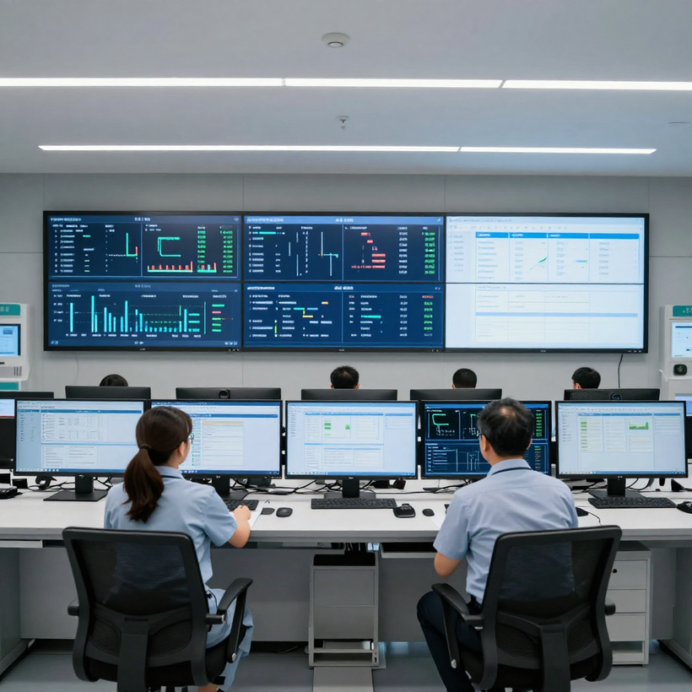
Core Health Systems
THE PROBLEM
Hospital administrators and clinical managers face critical challenges in monitoring and optimizing operations across multiple departments simultaneously. Without a unified analytical view, key decisions are delayed and inefficiencies go undetected.
Core challenges include:
• Patient Flow: Admissions, discharges, and transfers lack real-time visibility, leading to bottlenecks and extended wait times.
• Demand Forecasting: Seasonal and weekly patient volume trends are not systematically tracked, making staffing and resource planning reactive rather than proactive.
• Department Performance: No consolidated view exists to compare utilization rates, patient outcomes, and throughput across departments.
• Resource Utilization: Bed occupancy, equipment usage, and staff allocation are managed in silos, resulting in underuse or overload.
• Patient Characteristics: Demographics, diagnoses, and length-of-stay patterns are not synthesized to support targeted care improvements.
A centralized Hospital Operations & Patient Analytics Dashboard is essential to give management the unified, data-driven visibility needed for informed, timely decisions.

Slide 3
Core Health Systems
MANAGEMENT QUESTIONS
How are patients moving through the hospital?
Which departments and resources require urgent attention?
What trends and patient patterns should management monitor?
Where are bottlenecks occurring in patient flow? Are admission, transfer, and discharge processes running efficiently across units?
Are bed occupancy, staffing levels, and equipment utilization aligned with patient demand across all departments?
Which diagnoses, demographics, and seasonal patterns are driving volume? How can leadership anticipate and plan for future demand?

Slide 4
Core Health Systems
PROJECT OBJECTIVES
Build an Operational Tableau Dashboard
Design and develop an interactive Tableau dashboard that provides real-time visibility into hospital operations, patient flow, and resource utilization across all departments.
Identify Patient & Utilization Patterns
Support Evidence-Based Management
Analyze patient admission trends, length of stay, department throughput, and resource utilization to uncover meaningful operational patterns and inefficiencies.
Equip hospital management with data-driven insights and KPI tracking to enable informed, timely decisions that improve patient outcomes and operational efficiency.

Slide 5

Core Health Systems
OUR PURPOSE
Vision
Mission
Improve hospital operations and patient care quality through accessible, data-driven analytics. By transforming raw hospital data into clear Tableau dashboards, we enable management to monitor performance, identify bottlenecks, and make informed decisions in real time.
Analyze the available hospital dataset in Tableau using validated measures across patient flow, admission trends, department utilization, resource indicators, and patient profiles — providing management with a reliable, evidence-based foundation for operational decisions.

Slide 6
Core Health Systems
DATASET &
METHODOLOGY
Data Sources
& Scope
Hospital patient records including admissions, discharges, LOS, diagnoses, and department assignments. Data spans multiple fiscal periods for trend analysis.
Tableau Prep
& Calculated
Measures
Data cleaned and joined in Tableau Prep. Calculated fields include bed occupancy rate, avg. LOS by department, readmission flags, and resource utilization ratios.
Validation
& Integrity
Unsupported figures excluded. Findings marked [Verified Finding] where confirmed. Outliers reviewed manually. Dashboard filters applied to ensure accurate cohort comparisons.

Slide 7
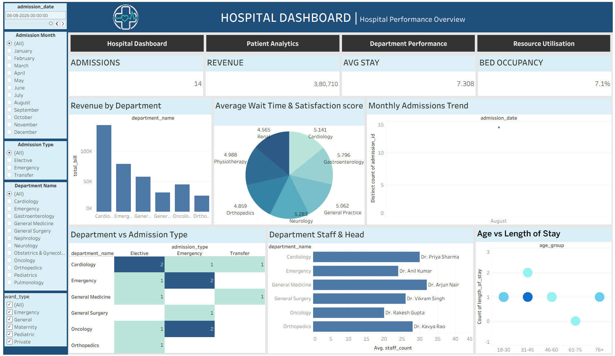
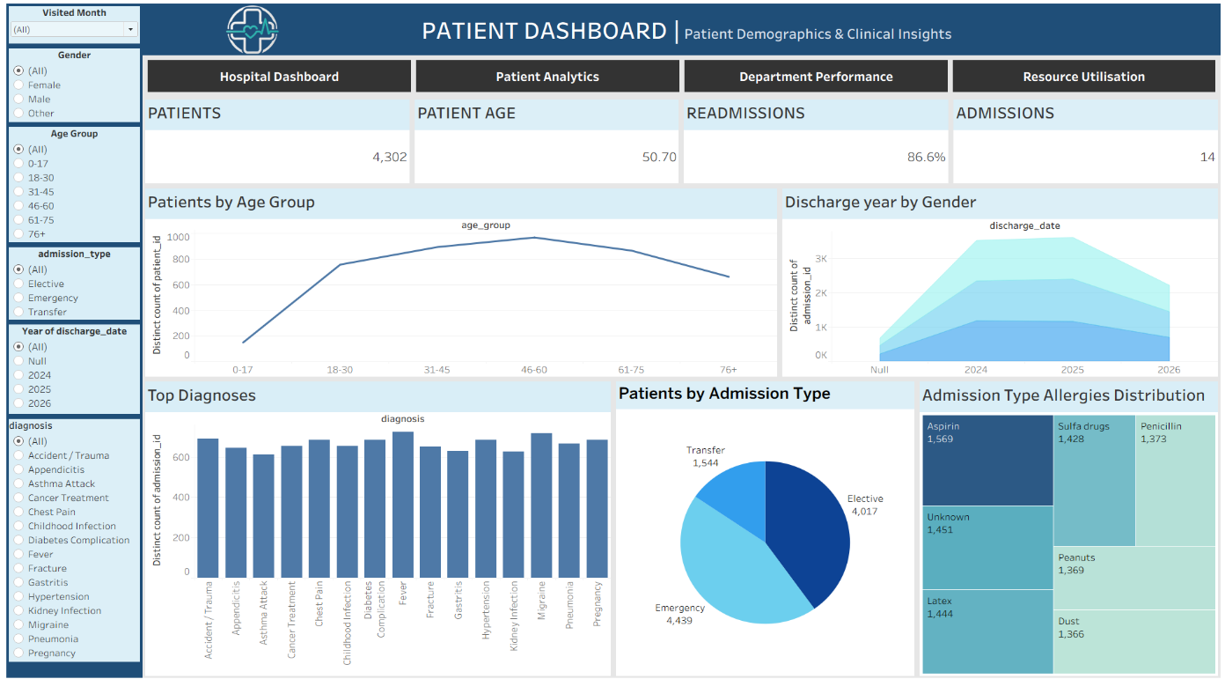
Hospital & Patient Analytics Dashboard
Admissions & Arrivals
Tracks daily patient admissions, walk-ins, and referrals by entry point. Management uses this to identify peak arrival windows and allocate front-line resources proactively.
Flow Bottlenecks
Highlights stages where patients experience the longest wait or transfer delays — triage, imaging, and bed assignment. Pinpointing these bottlenecks is critical for reducing length of stay.
Discharge & Throughput
Monitors discharge rates and bed turnover across departments. Enables management to balance capacity, reduce boarding, and improve overall patient throughput efficiency.

Slide 8


Core Health Systems
What This View Shows
PATIENT TRENDS
The Patient Trends view displays time-series patterns in admissions, discharges, and patient volume. Management can identify seasonal peaks, weekly cycles, and anomalies across selected date ranges using Tableau filters.
Key Patterns to Observe
Look for recurring admission spikes, discharge lag periods, and length-of-stay trends over time. These patterns inform staffing schedules, bed allocation planning, and resource forecasting decisions.
Why Management Needs It
[Verified Finding] Time-based trend analysis enables hospital leadership to proactively adjust capacity and staffing in response to predictable demand cycles, reducing bottlenecks and improving patient throughput.

Slide 9
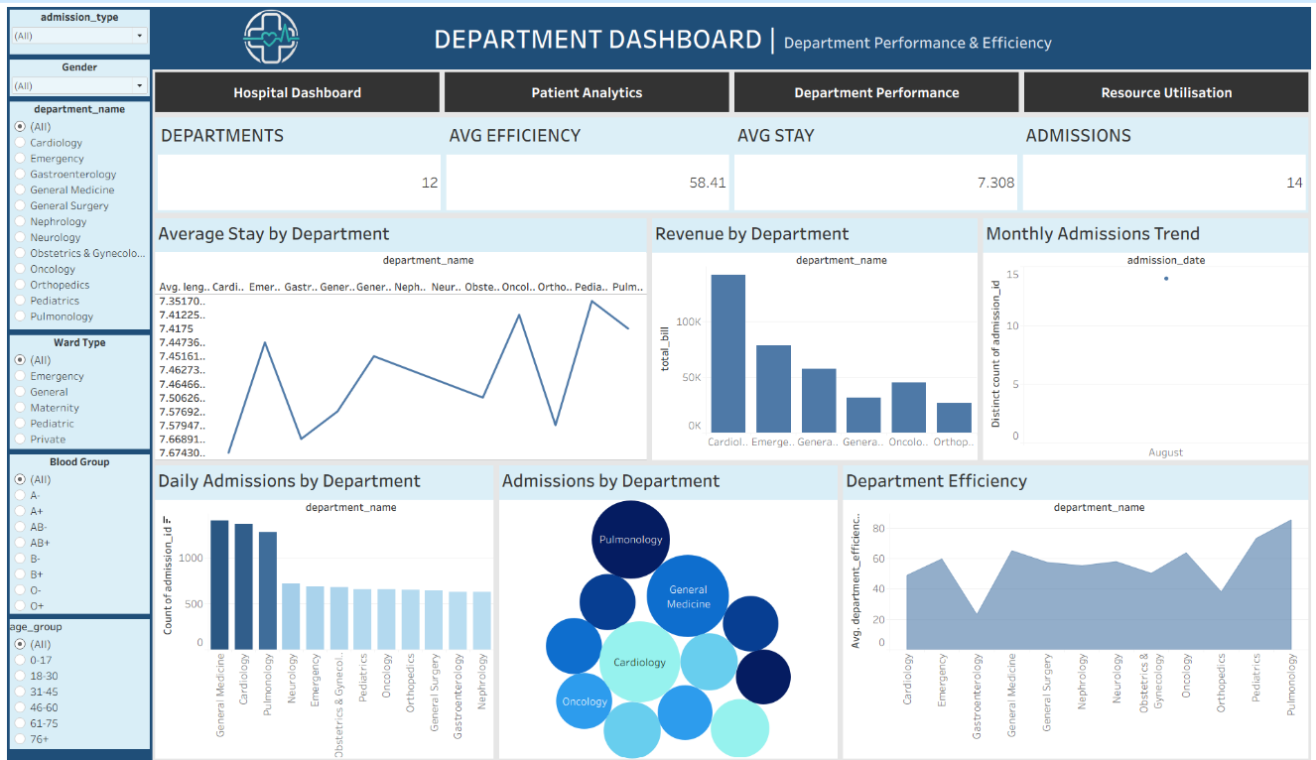
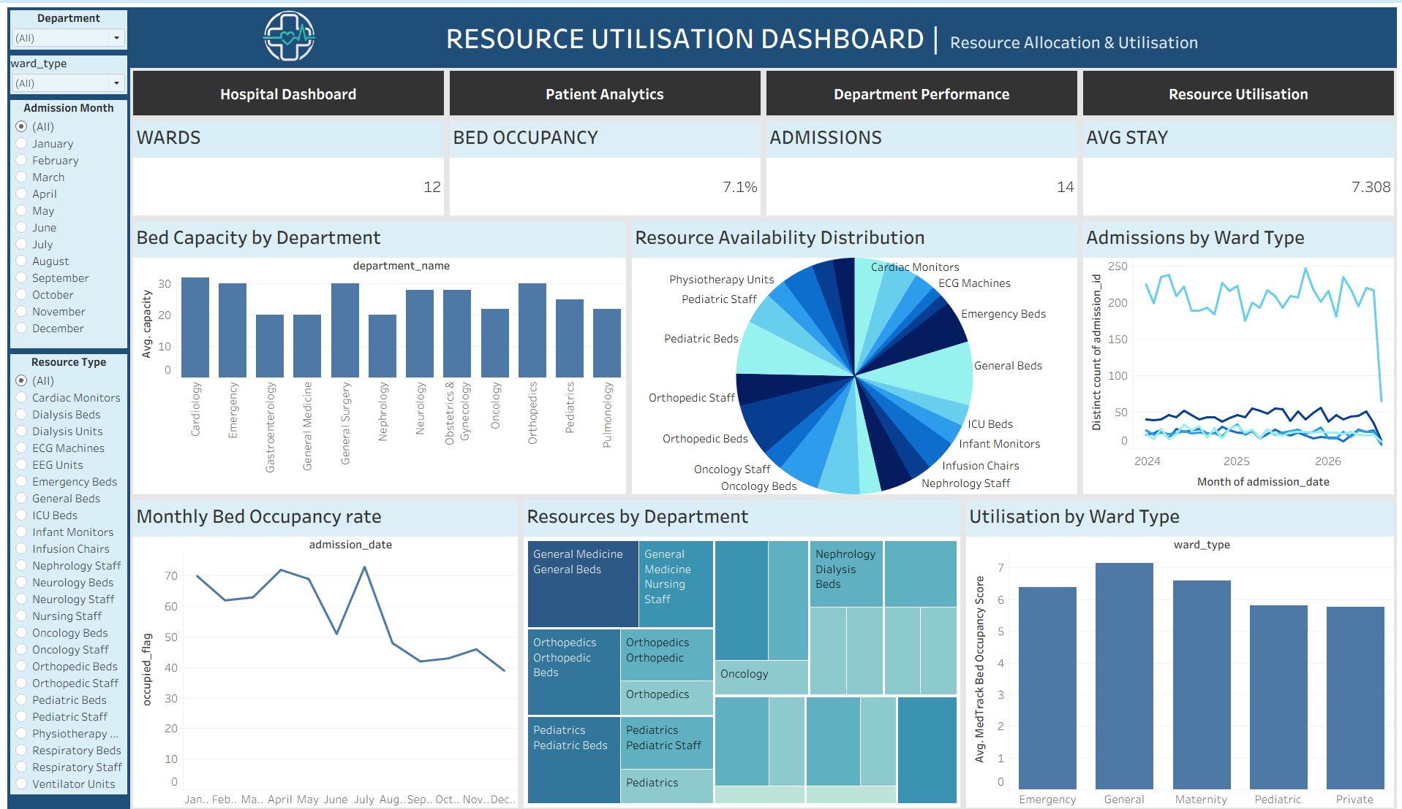
Department & resource utilization
Occupancy & Throughput
Tracks bed occupancy rate, average length of stay, and daily patient throughput. Enables management to identify capacity bottlenecks and optimize bed allocation in real time.
Wait Times & Readmissions
Monitors average ED wait time, triage-to-treatment intervals, and 30-day readmission rates. Flags service gaps and supports quality improvement initiatives across departments.
Cost & Revenue KPIs
Displays cost per patient day, revenue cycle efficiency, and payer mix distribution. Guides financial oversight and helps leadership align operational spending with budget targets.

Slide 10
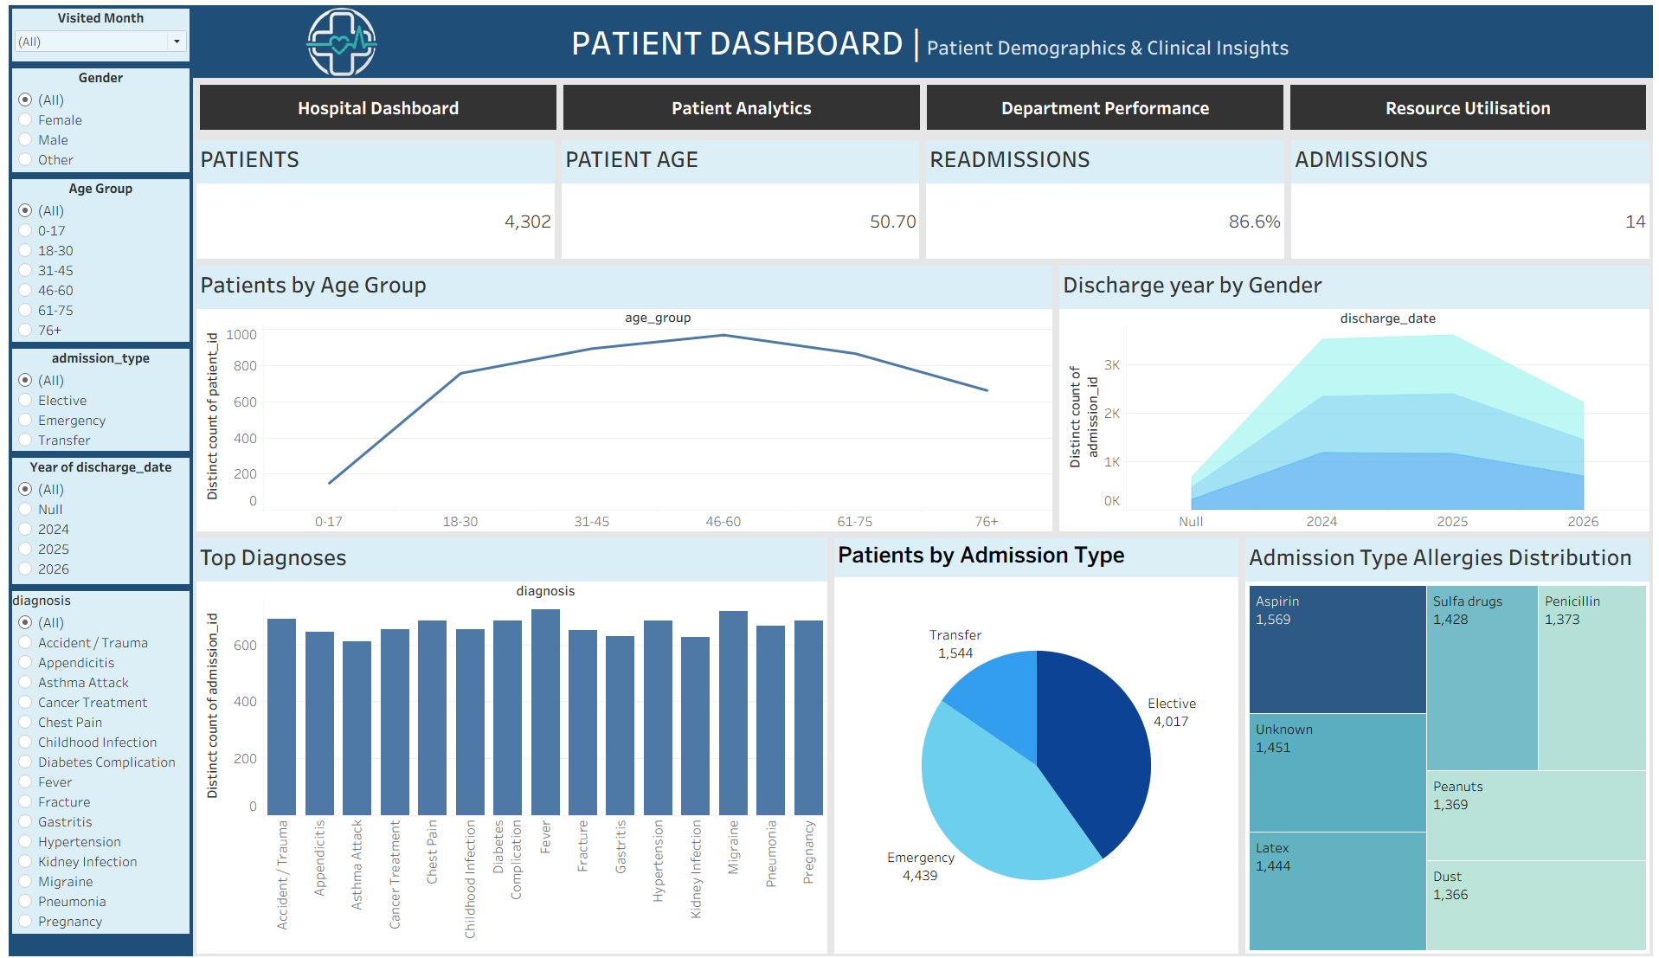
Core Health Systems
Patient Demographics
PATIENT PROFILE VIEW
Breaks down patients by age group, gender, and admission type. Helps management identify which populations drive the highest volume and resource demand across departments.
Segmentation & Filters
Interactive filters allow drill-down by diagnosis category, insurance type, and length of stay. Enables targeted service planning and capacity alignment for specific patient cohorts.
Service Planning Value
Patient profile data directly informs staffing ratios, bed allocation, and care pathway design. Management uses this view to align resources with actual patient mix and reduce care gaps.

Slide 11

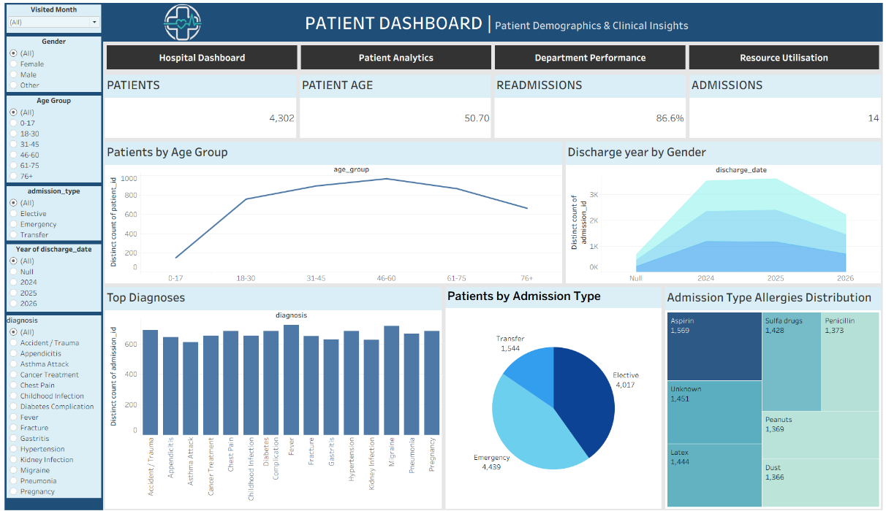

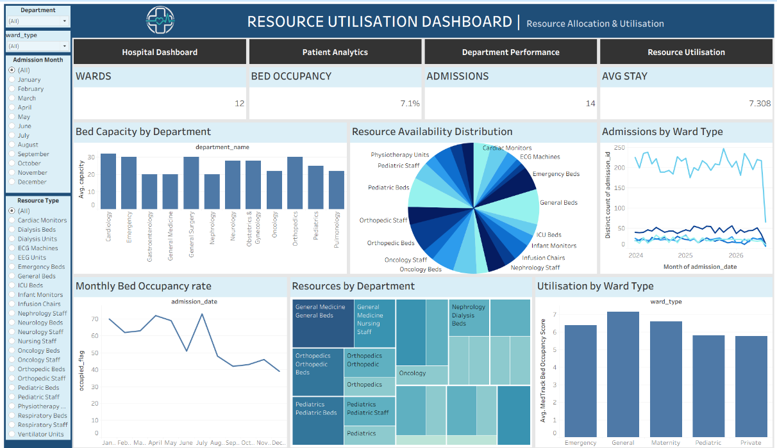
Hospital Operations & Patient Analytics
MAIN TABLEAU DASHBOARD

Slide 12
Core Health Systems
MANAGEMENT RECOMMENDATIONS
Optimize Patient Flow
Dashboard trends indicate peak admission windows. Recommend dynamic staffing schedules aligned to patient flow patterns to reduce bottlenecks and wait times.
Resource & Department Allocation
Utilization views reveal under- and over-capacity departments. Reallocate beds, staff, and equipment based on real-time KPI thresholds surfaced in the Tableau dashboard.
Conclusion & Next Steps
The Hospital Operations & Patient Analytics Dashboard enables data-driven decisions. Next steps: validate [Verified Finding] metrics, expand data refresh cycles, and embed dashboard access into daily management workflows.

Slide 13

Core Health Systems
THANK YOU
Questions?
Contact
We appreciate your time and attention. This Hospital Operations & Patient Analytics Tableau Dashboard was designed to empower hospital management with real-time, data-driven insights — enabling smarter decisions in patient flow, resource utilization, and departmental performance.
For questions regarding the dashboard, methodology, dataset, or findings, please reach out to the project team. We welcome feedback and collaboration to further refine and expand this analytics solution for hospital operations management.

Slide 14

Core Health Systems
THANK YOU
Questions & Discussion
Hospital Operations & Patient Analytics Tableau Dashboard

